Slide 1


Planning Parking Maneuvers for a Car-Trailer Vehicle
Autonomous and Mobile Robotics
Prof. Giuseppe Oriolo
Supervisors: Ph.D. Tommaso Belvedere
Ph.D. Michele Cipriano
Leandro Maglianella - 1792507
Lorenzo Nicoletti - 1797464
Olga Sorokoletova - 1937430

Slide 2
Outline of the project
Project Description
framework
car-trailer robot
jackknifing problem
experimental environments
baseline planner (RRT)
Optimal Planning
optimal planner (SST)
optimization objectives
comparing results with baseline
Handling problem
introducing obstacles
handling jackknifing (CL-RRT)
Conclusion

Slide 3
Project Description

Slide 4
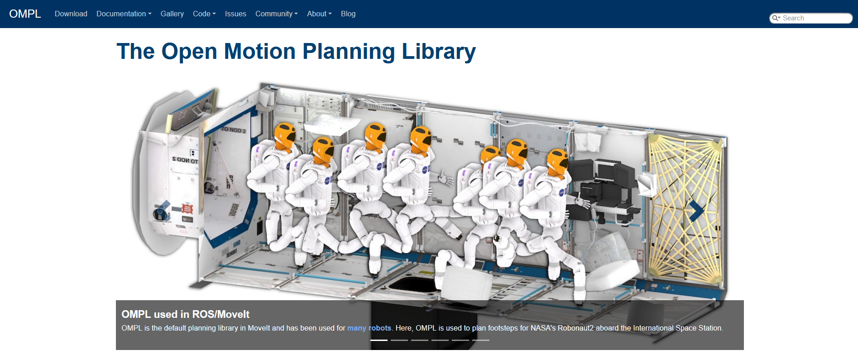
Project Description: framework
integrable into large variety of external systems
environment specification, collision detection and visualization are left to the user

Slide 5
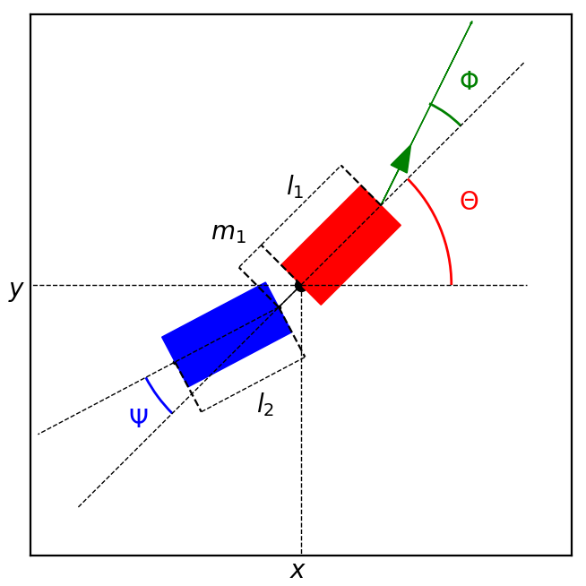
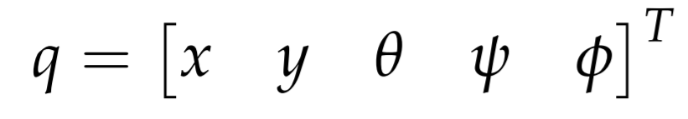
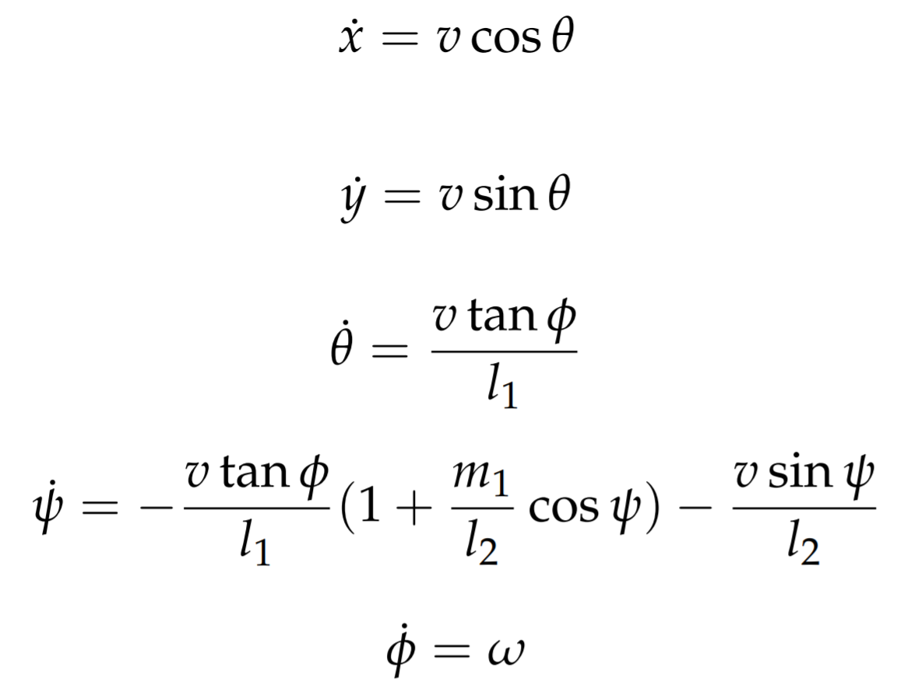
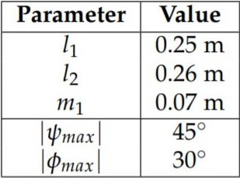
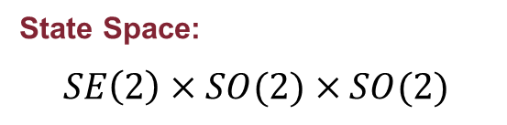
Project Description: car-trailer robot
State Space:
$$SE\left(2\right)×SO(2)×SO(2)$$
State:
Kinematic model:

Slide 6
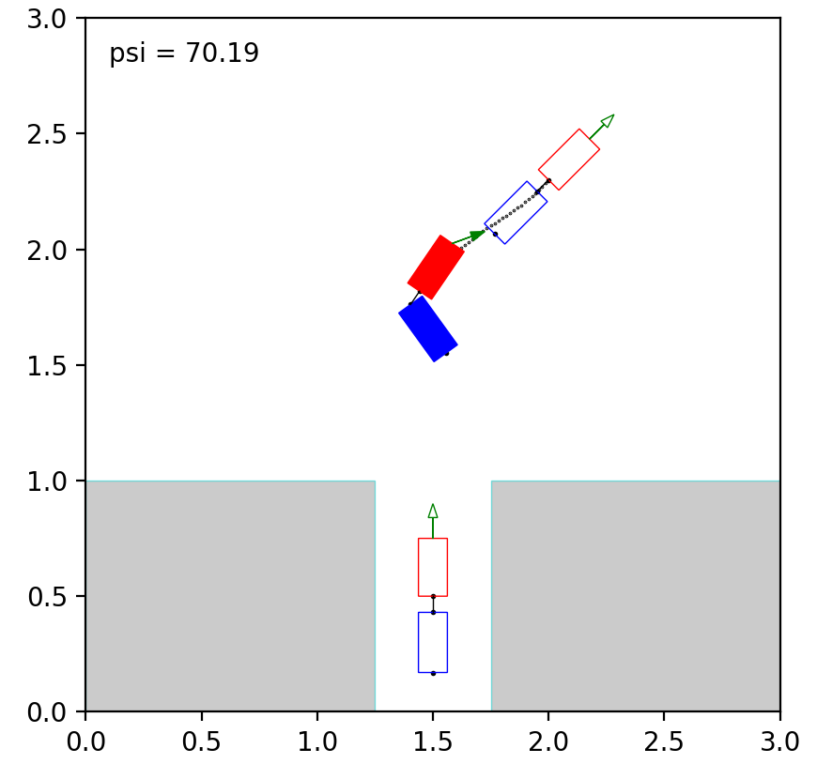
Project Description: jackknifing problem
Jackknifing phenomenon: while moving backward, the hitch angle can start to diverge (instability)
loss of maneuverability and risk of self-collision

Slide 7
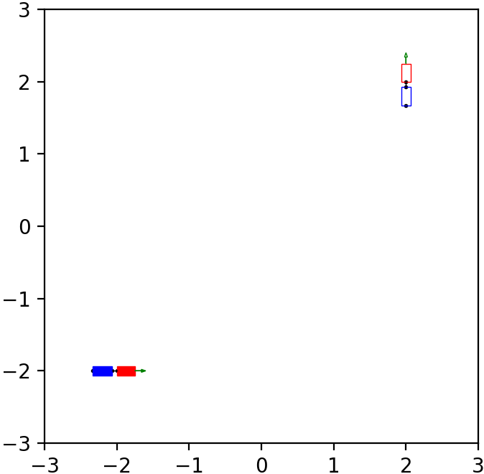
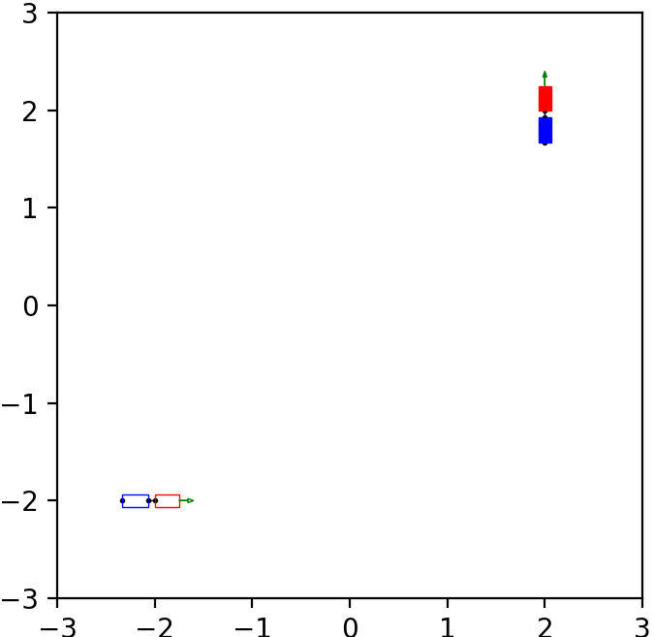
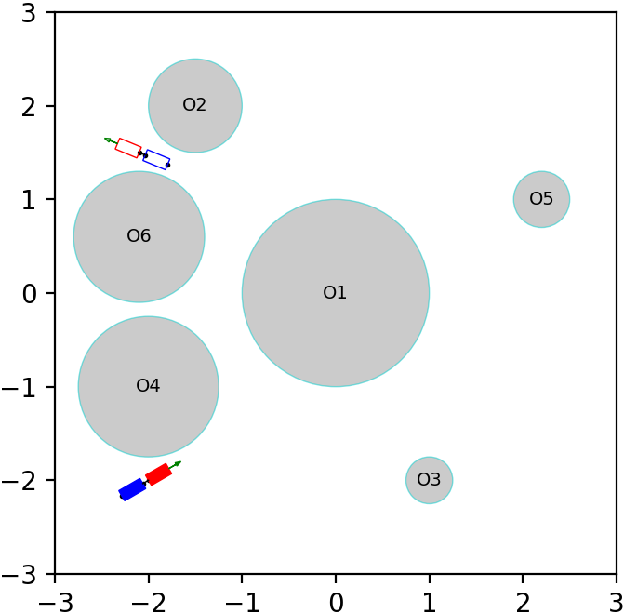
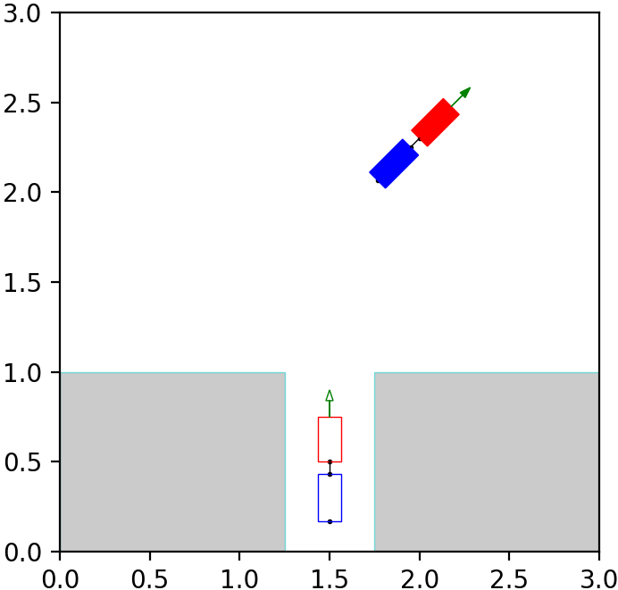
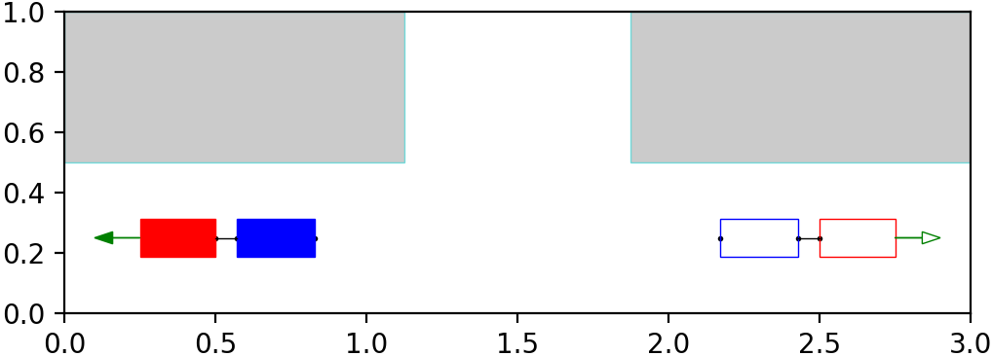
Project Description: experimental environments
a) Simple forward motion
b) Simple backward motion
c) Circular obstacles avoidance
d) Three point turn
e) Real parking test

Slide 8
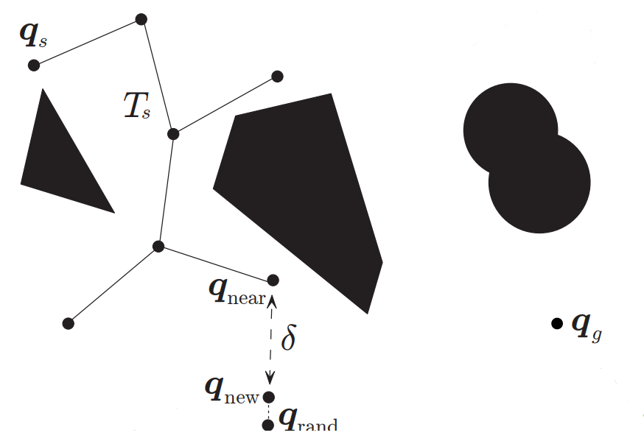
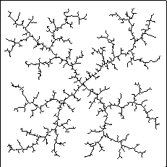
Project Description: baseline planner (RRT)
Rapidly-Exploring Random Tree (RRT) is a probabilistically complete sampling-based planning algorithm, which builds the exploration tree by performing the following steps:
sampling of a random state in the configuration space
searching for the closest amongst the visited states
expansion until some new state is reached
adding of a new state to the exploration tree, if no collisions
control inputs
driving velocity​
steering velocity

Slide 9
Optimal Planning
SST planner

Slide 10
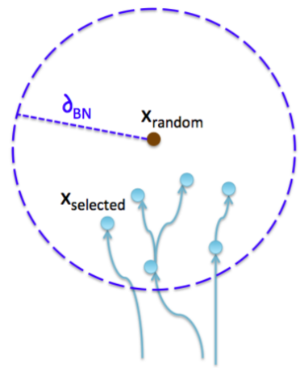
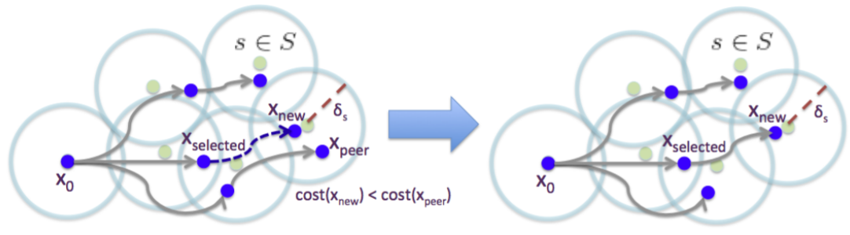
Optimal Planning: SST planner
Stable Sparse RRT (SST) is an asymptotically near-optimal incremental modification of RRT, that enables optimal planning.
It can:
keep the number of stored nodes small
quickly converge to high-quality paths
be combined with desired optimization objectives
control inputs
driving velocity​
steering velocity
For N iterations, a selection/propagation/pruning procedure is followed.

Slide 11

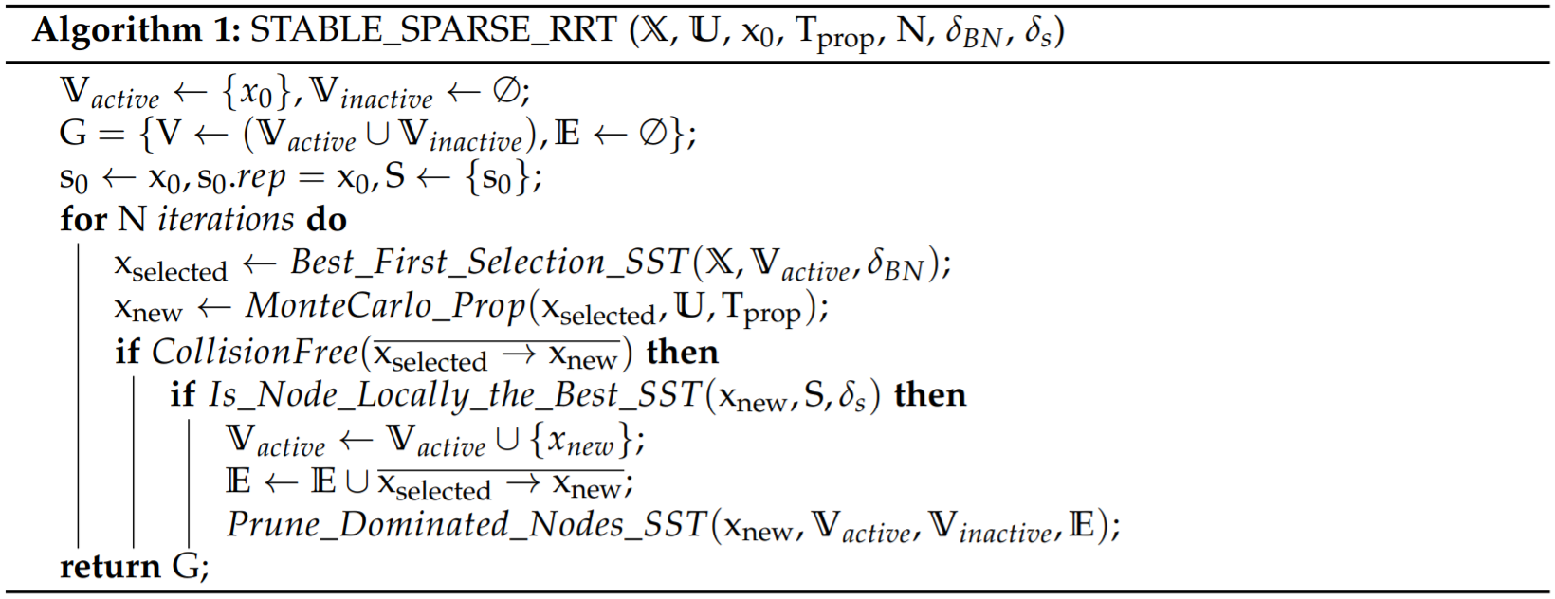
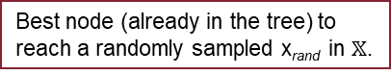
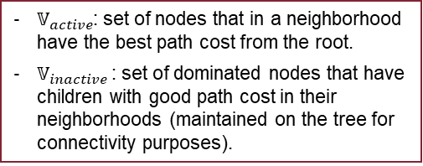
Optimal Planning: explaining SST
State space
Control space
Initial state
Max propagation time
Number of iterations
Distance used for x_{selected} choice
Distance supervised by each witness s
V: tree nodes
E: tree edges
S: set of witnesses
Best node (already in the tree) to reach a randomly sampled x_{rand} in $𝕏$.
Node reached from x_{selected} using the control sampled by MonteCarlo
Is the path to x_{new} safe?
Has x_{new} locally the best path cost?
$𝕍_{active}$: set of nodes that in a neighborhood have the best path cost from the root.
$𝕍_{inactive}$: set of dominated nodes that have children with good path cost in their neighborhoods (maintained on the tree for connectivity purposes).

Slide 12
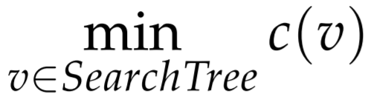
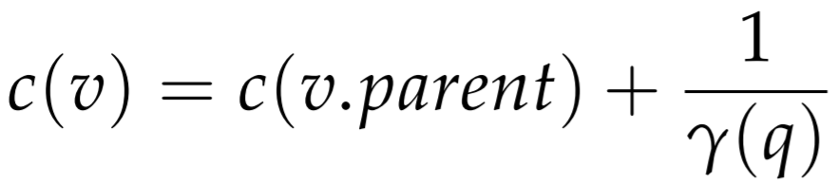
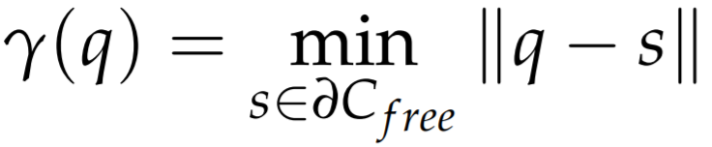
Optimal Planning: optimization objectives
For optimization problem, formulated as:
Path Length Minimization objective optimizes the length of the path in order to avoid excessive wandering
Path Clearance Maximization objective steers away from obstacles to efficiently increase safety
where

Slide 13
Optimal Planning
Compare results with baseline planner

Slide 14
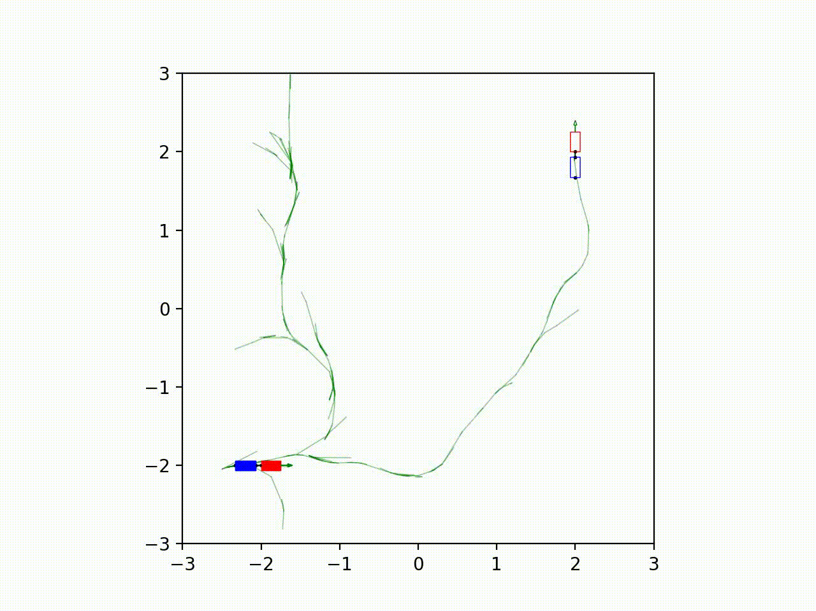
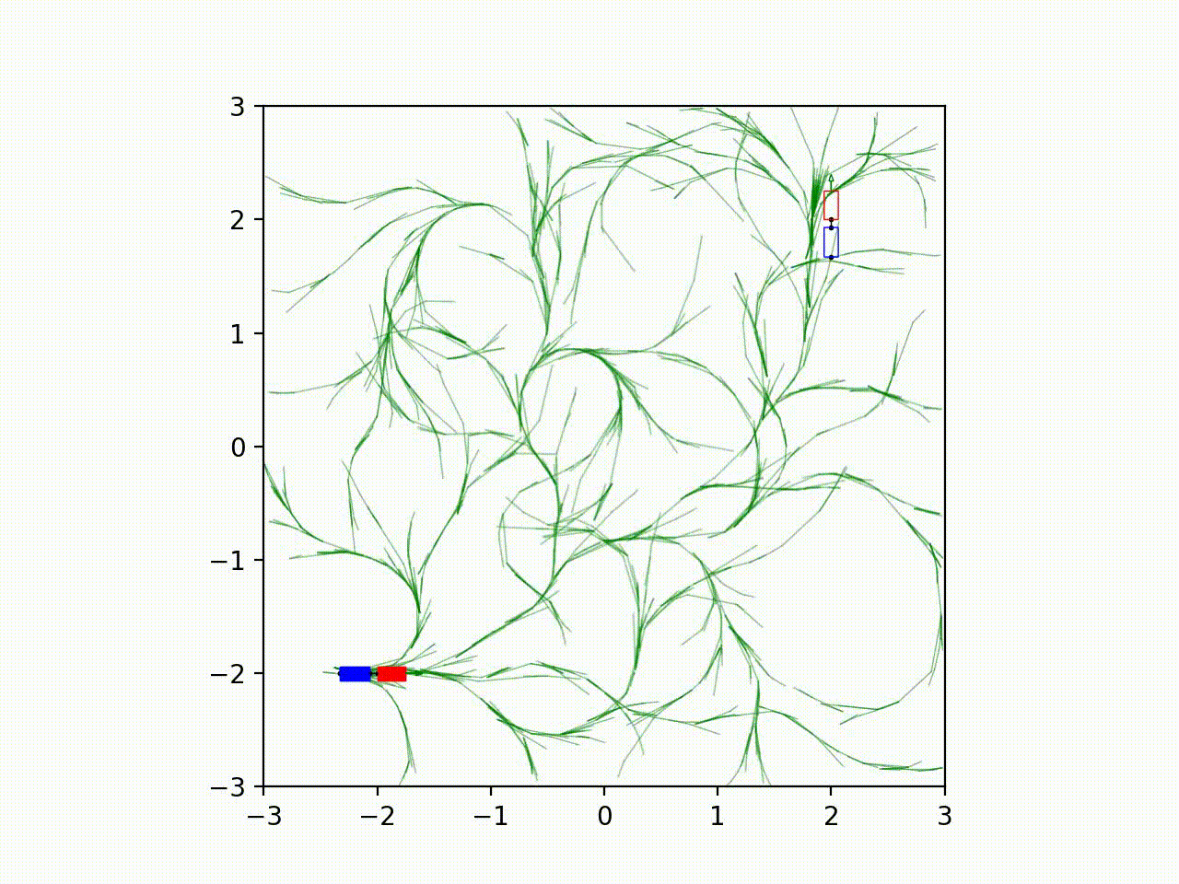
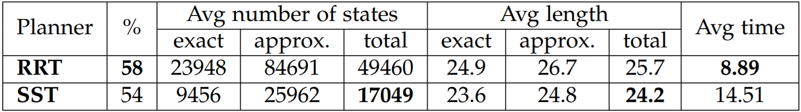
Compare results: simple forward motion
RRT
SST

Slide 15
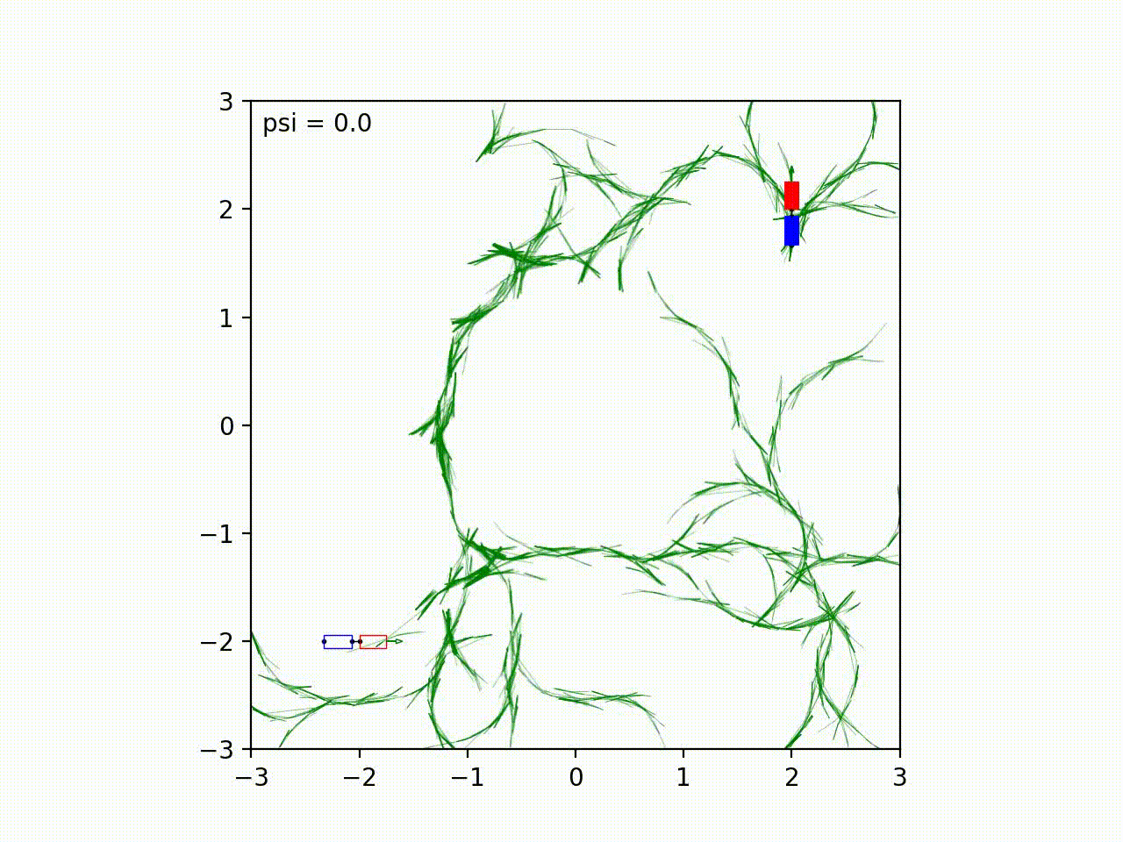
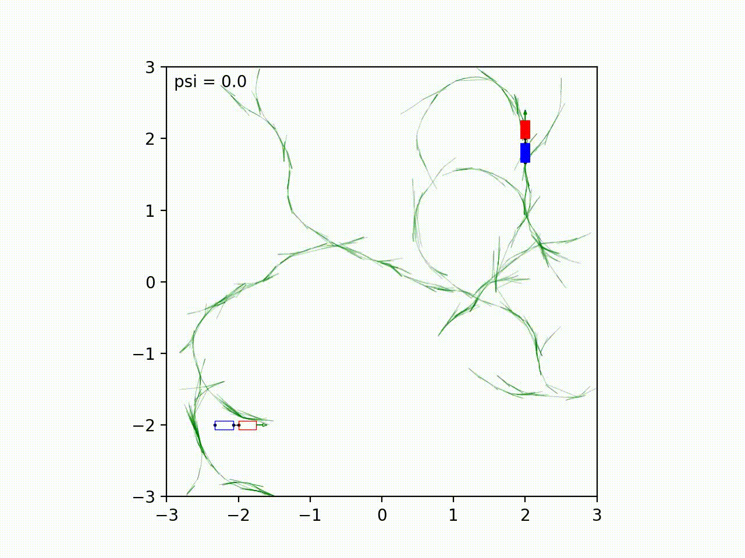
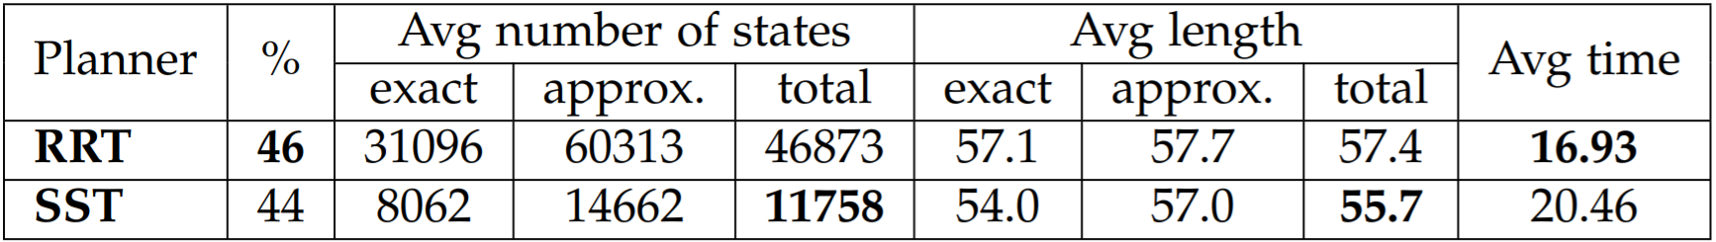
Compare results: simple backward motion
RRT
SST

Slide 16
Handling problem
Introducing obstacles

Slide 17
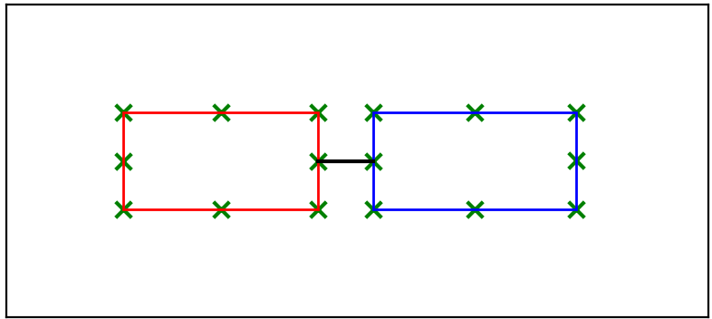
Introducing obstacles: collision checker
Collision-checking is performed considering a finite set of control points, defined along the robot's body:
Текст слайда
Текст слайда
Текст слайда

Slide 18
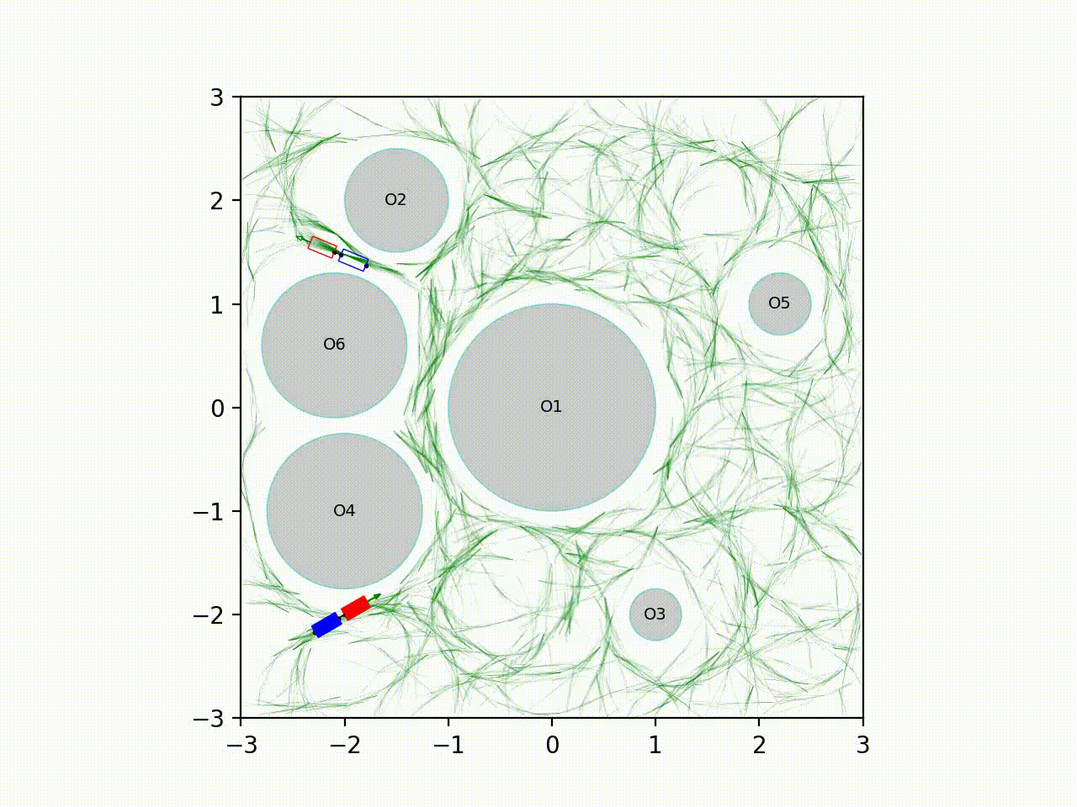
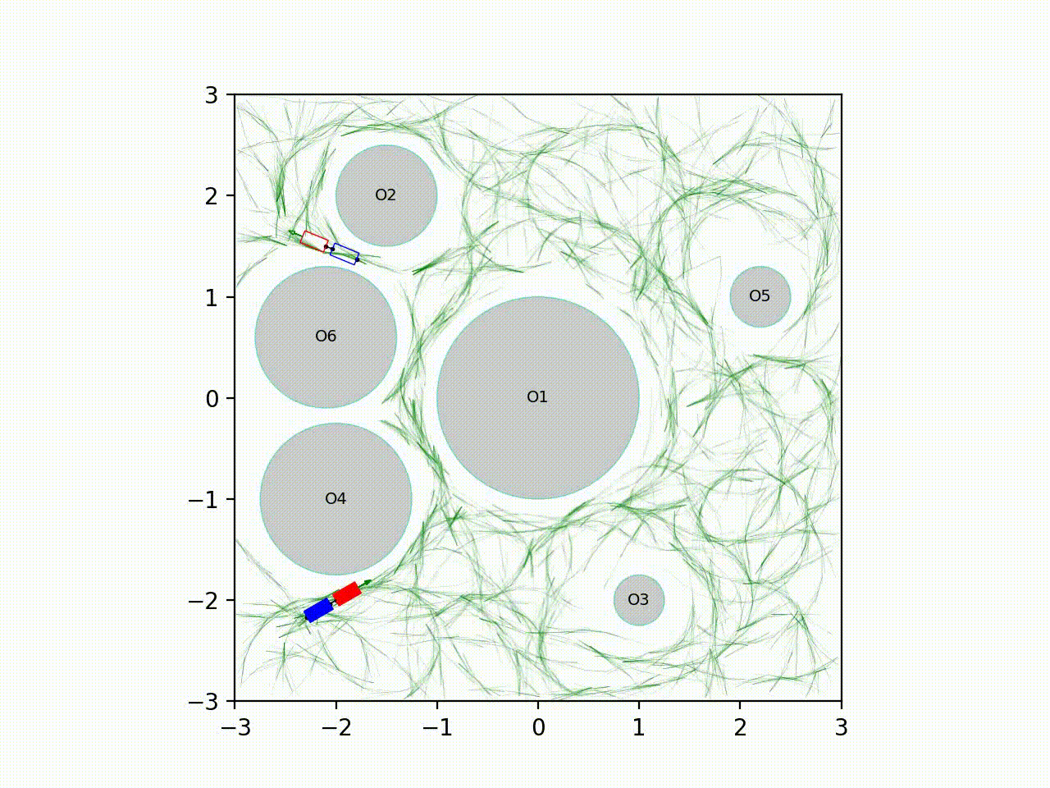
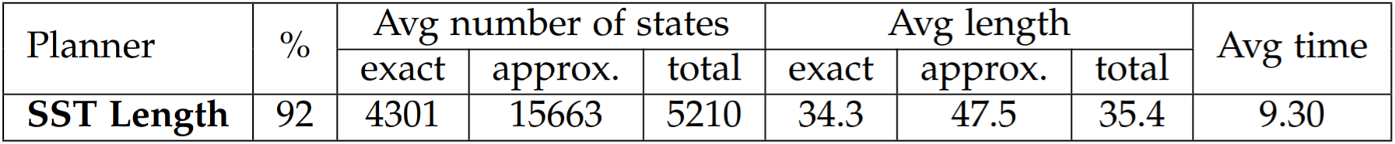
Introducing obstacles: circular obstacles avoidance
SST Path Length
SST Path Clearance

Slide 19
Handling problem
Handling jackknifing

Slide 20
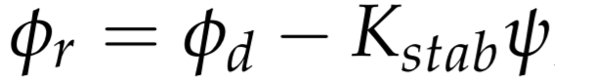
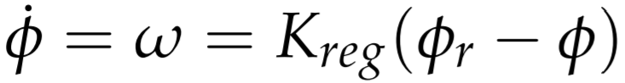
Handling jackknifing: CL-RRT
Closed-Loop RRT (CL-RRT) is a modification of RRT which aims to overcome the problem of the hitch angle divergence by countersteering before reaching a jackknife state.
Then the steering velocity is used to track such reference quantity using the standard proportional feedback control:
CL-RRT's underlined idea is to perform the cascaded control by means of introduction of a closed-loop dynamics.
Sampled desired steering angle is used to compute the reference steering angle:
control inputs
driving velocity​
desired steering angle​

Slide 21
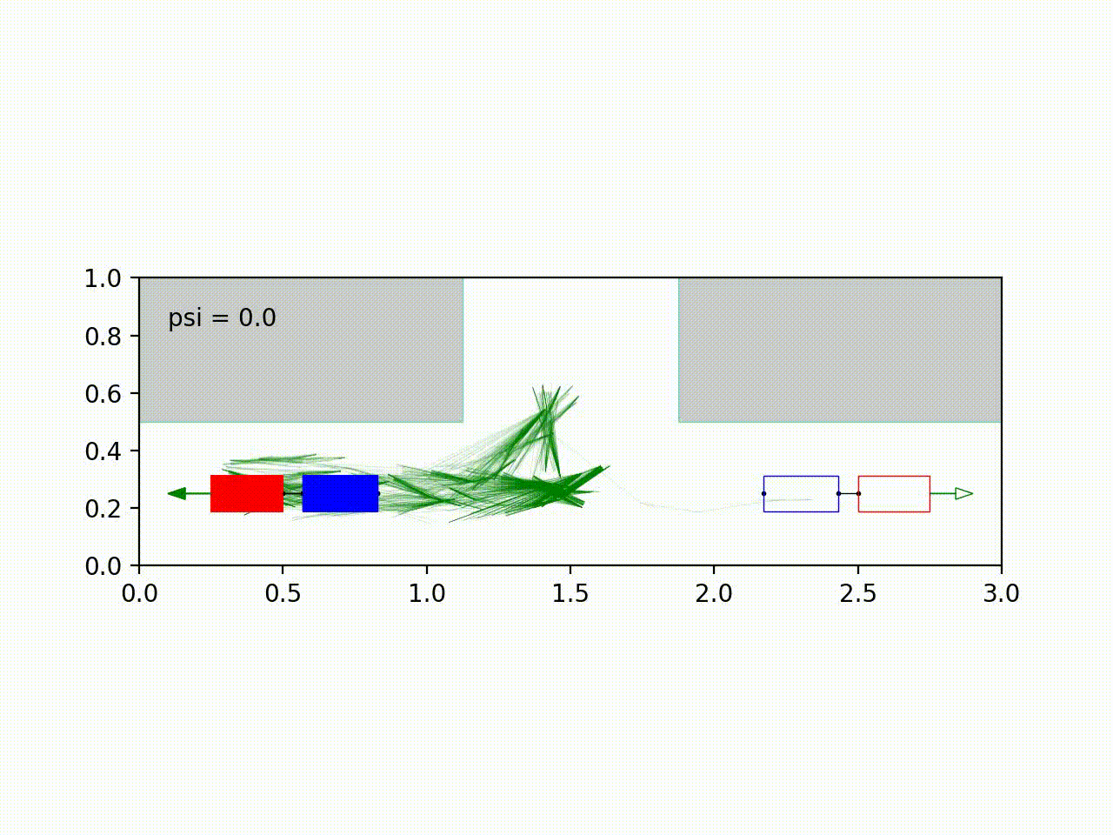
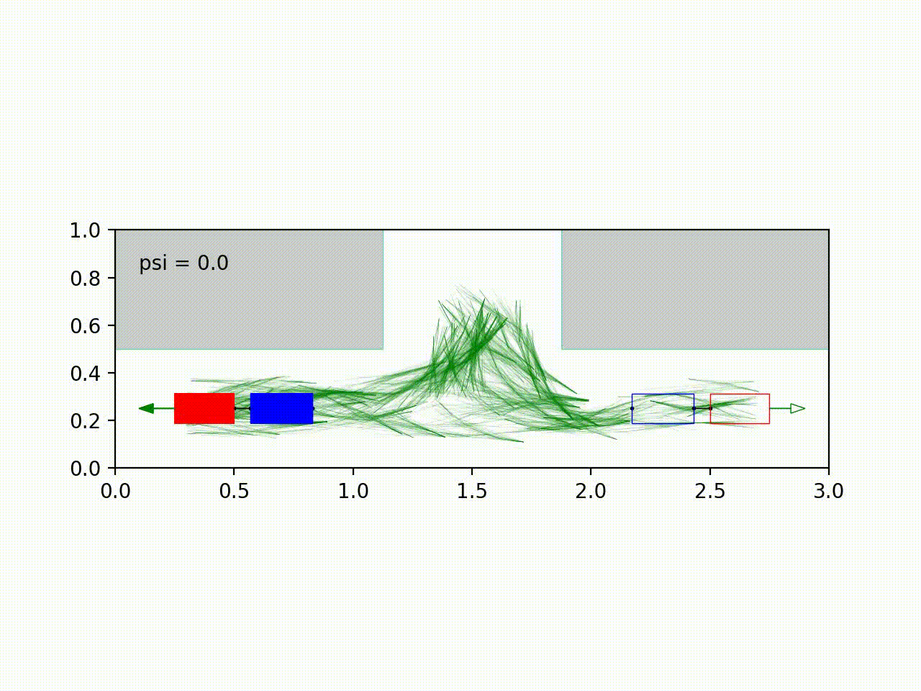
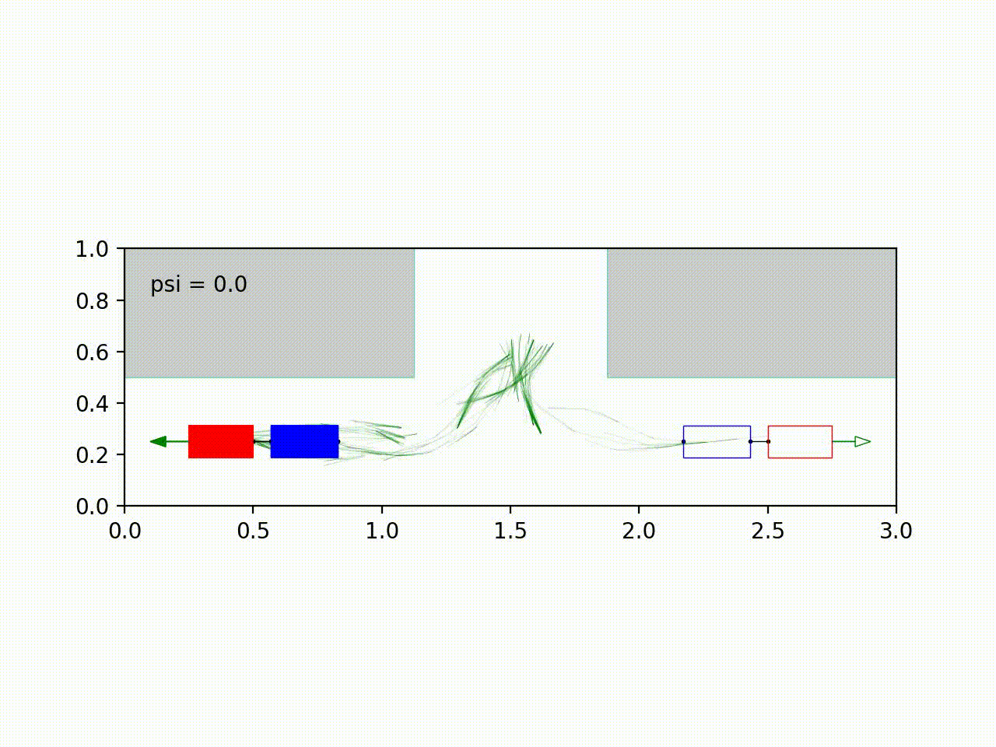
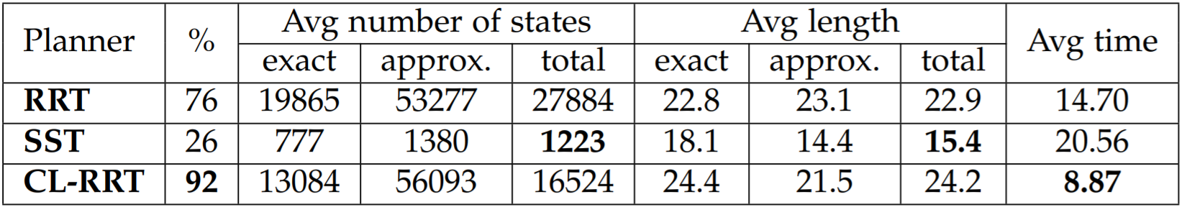
Handling jackknifing: three-point turn
RRT
SST
CL-RRT

Slide 22
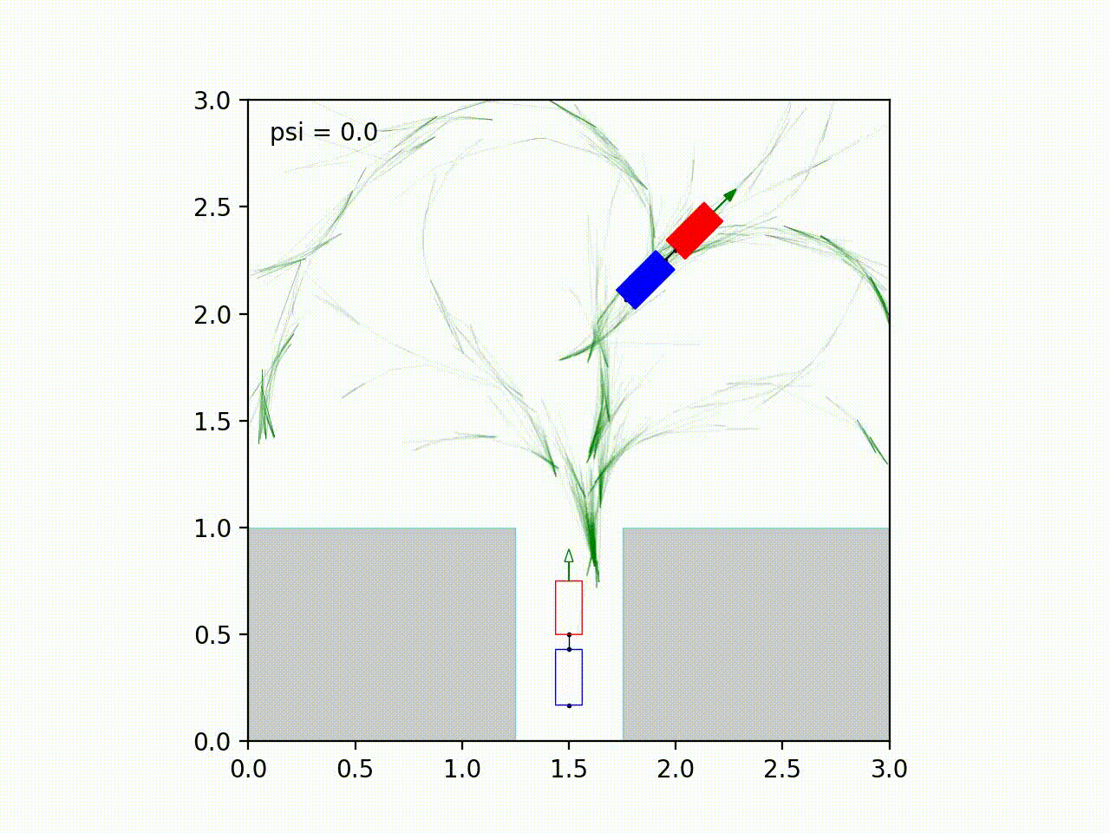
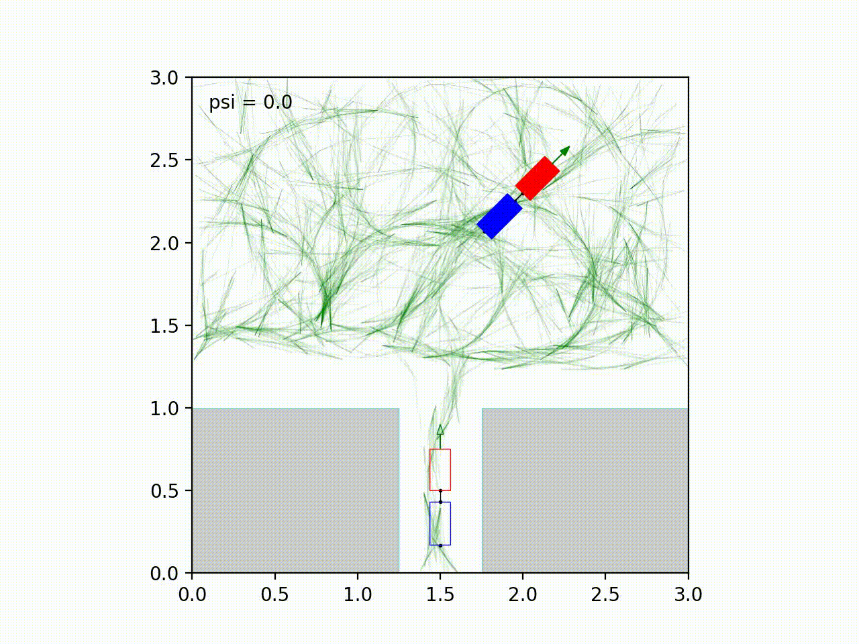
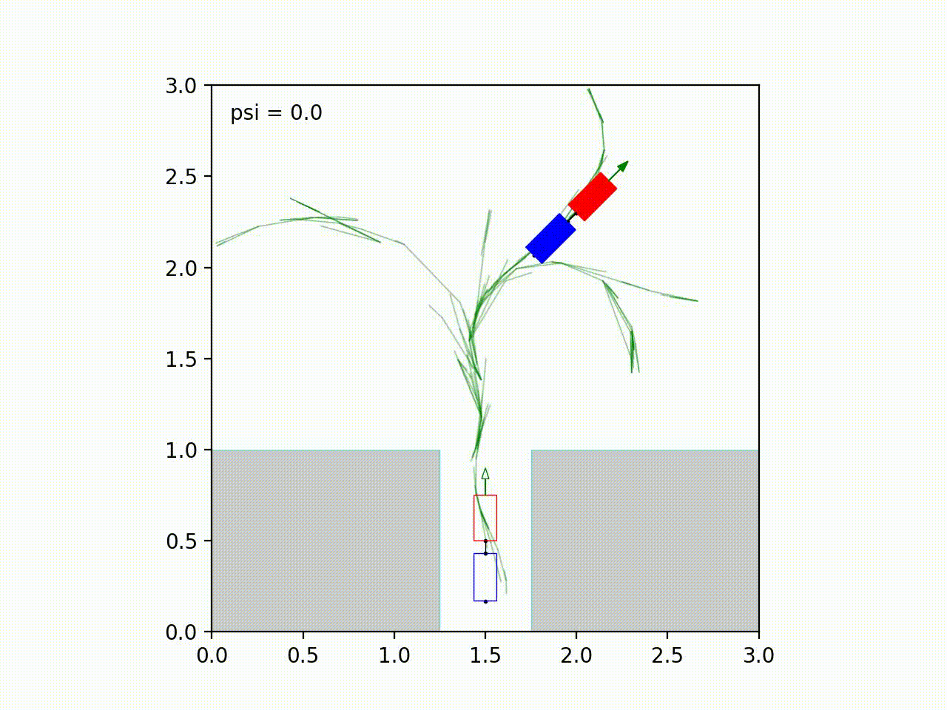
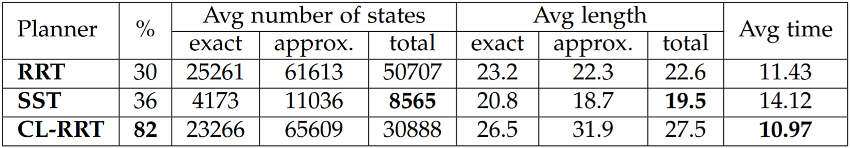
Handling jackknifing: real parking test
RRT
SST
CL-RRT
CL-RRT

Slide 23
Conclusion

Slide 24
Conclusion
we developed a programming pipeline that provides OMPL’s omitted components to perform motion planning with a car-trailer vehicle
all the three planners (RRT, SST, CL-RRT) have been tested and evaluated in a wide set of experiments and scenarios in order to fully explore their potentialities
the optimal planning introduced with SST has allowed to achieve higher-quality paths and better performances with respect to the baseline RRT
the jackknifing phenomenon has been efficiently handled in increasing-complexity environments
the most satisfactory results were obtained with the introduction of the Closed-Loop in the dynamic system
the project can be further extended to include new objectives, N-trailer structures and additional CL-based planners.

Slide 25
References
Evestedt N., Ljungqvist O., Axehill D.
"Motion planning for a reversing general 2-trailer configuration using Closed-Loop RRT", IROS 2016
Beglini M., Lanari L., Oriolo G.
"Anti-Jackknifing Control of Tractor-Trailer Vehicles", 2020 IEEE International Conference on Robotics and Automation (ICRA)
Open Motion Planning Library
http://ompl.kavrakilab.org/
Li Y., Littlefield Z., Bekris K. E.
"Asymptotically Optimal Sampling-based Kinodynamic Planning", 2016

Slide 26
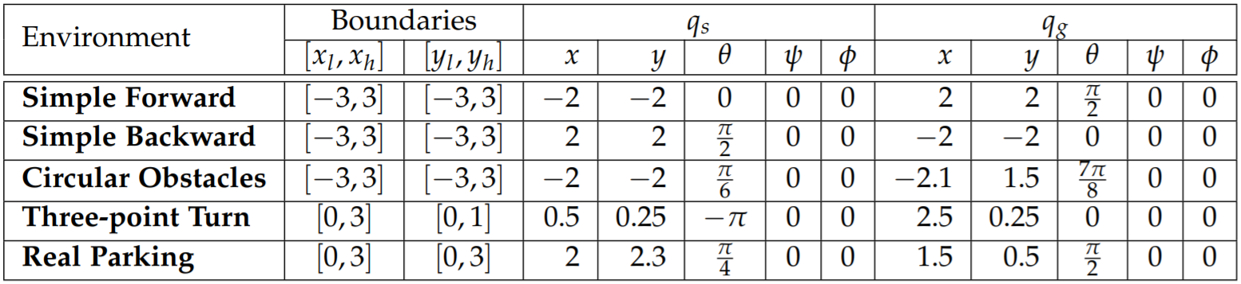
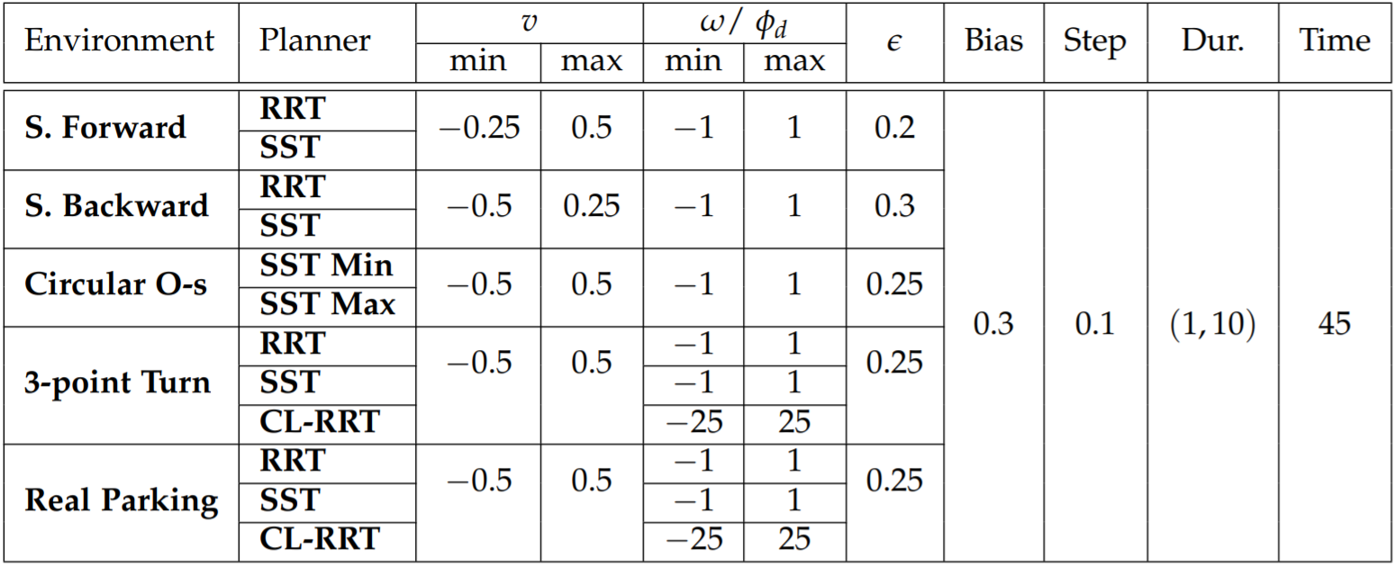
Appendix
Environmental parameters: state space bounds for the Cartesian components, initial and goal configuration.
Hyper-parameters: driving velocity, steering velocity, goal threshold ϵ, goal bias, propagation step size, control duration and maximum time limit to return an exact solution. SST Min and SST Max stand for SST with Minimum Path Length objective and SST with Maximum Path Clearance objective, respectively.

Slide 27
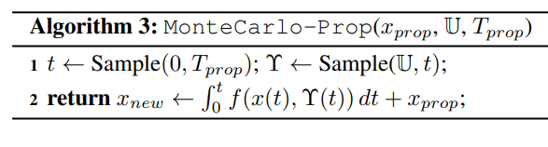
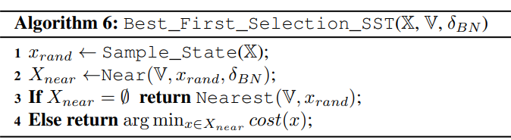
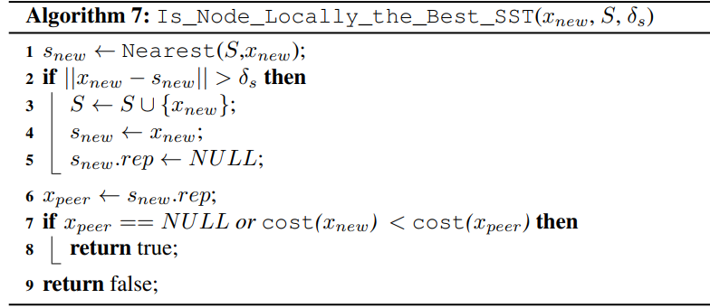
Appendix

Slide 28
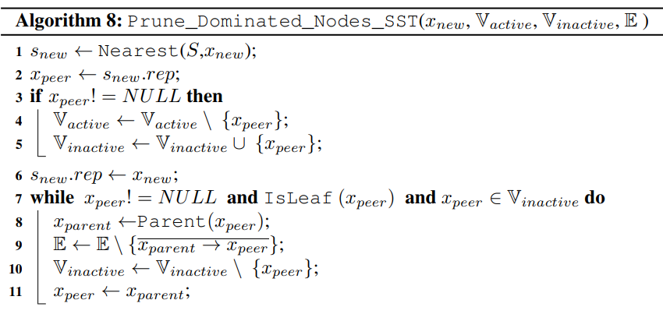
Appendix

